Slide 1
Financial Analysis
By:
Dr. Saurabh Chadha

Slide 2
Purpose of Financial Analysis
The goal of financial analysis is to assess the performance of a firm in the context of its stated goals and strategy.
There are two principal tools of financial analysis: Ratio analysis and Cash flow analysis.
Ratio analysis involves assessing how various line items in a firm’s financial statements relate to one another.
Ratio analysis of a company’s present and past performance provides the foundation for making forecasts of future performance.
Cash flow analysis allows the analyst to examine the firm’s liquidity, and how the firm is managing its operating, investment, and financing cash flows.

Slide 3
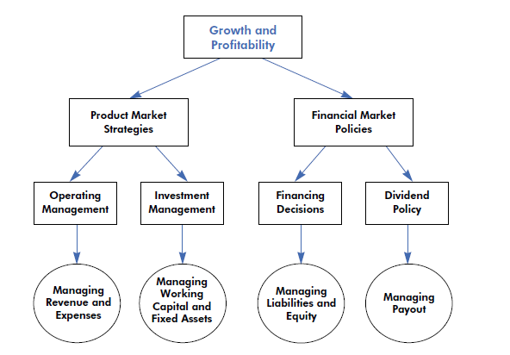
Ratio Analysis
Drivers of a Firm’s Profitability and Growth

Slide 4
Ratio Analysis
Thus, the four levers managers can use to achieve their growth and profit targets are: (1) operating management, (2) investment management, (3) financing strategy, and (4) dividend policies.
The objective of ratio analysis is to evaluate the effectiveness of the firm’s policies in each of these areas.
In ratio analysis, the analyst can
(1) compare ratios for a firm over several years (a time-series comparison)
(2) compare ratios for the firm and other firms in the industry (cross-sectional comparison)
(3) compare ratios to some absolute benchmark

Slide 5
Profitability Analysis
ROE = Net Income / Shareholder’s Equity
ROE is a comprehensive indicator of a firm’s performance because it provides an indication of how well managers are employing the funds invested by the firm’s shareholders to generate returns.
In the long run, the value of the firm’s equity is determined by the relationship between its ROE and its cost of equity capital.
ROE = ROA × Financial leverage
ROE can be decomposed into return on assets (ROA) and a measure of financial leverage

Slide 6
Profitability Analysis
ROE = ROA × Financial leverage
ROE can be decomposed into return on assets (ROA) and a measure of financial leverage.
ROE = Net income/Assets × Assets/Shareholder’s Equity
ROA tells us how much profit a company is able to generate for each dollar of assets invested.
Financial leverage indicates how many dollars of assets the firm is able to deploy for each dollar invested by its shareholders.

Slide 7
Profitability Analysis
ROA = Net income/sales × sales/assets
The ratio of net income to sales is called net profit margin
Ratio of sales to assets is known as asset turnover.
The profit margin ratio indicates how much the company is able to keep as profits for each dollar of sales it makes.
Asset turnover indicates how many sales dollars the firm is able to generate for each dollar of its assets.
Thus, the three drivers of ROE are: net profit margins, asset turnover, and financial leverage.

Slide 8
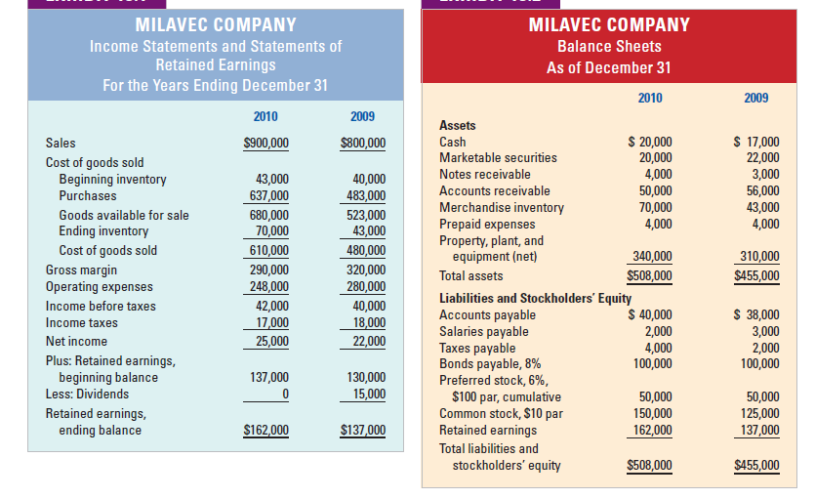
Ratio Analysis

Slide 9
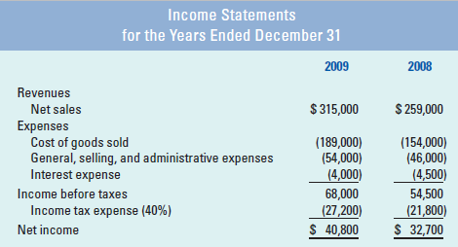
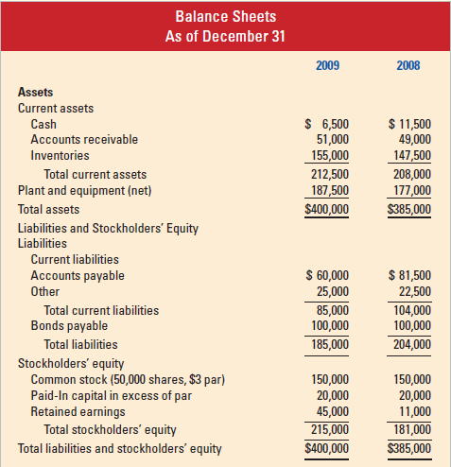
Ratio Analysis

Slide 10
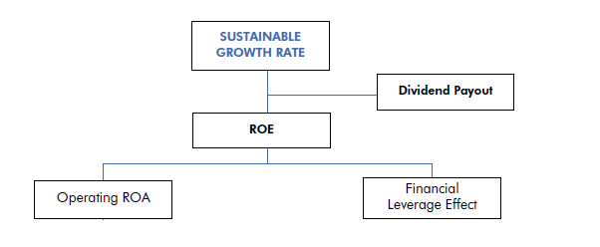
Sustainable Growth Rate
A firm’s sustainable growth rate is defined as:
Sustainable growth rate = ROE × ( 1 – Dividend payout ratio )

Slide 11
Sustainable Growth Rate
Sustainable growth rate is the rate at which a firm can grow while keeping its profitability and financial policies unchanged.
A firm’s return on equity and its dividend payout policy determine the pool of funds available for growth.
Of course, the firm can grow at a rate different from its sustainable growth rate if its profitability, payout policy, or financial leverage changes.
Therefore, the sustainable growth rate provides a benchmark against which a firm’s growth plans can be evaluated.

Slide 12
CASH FLOW ANALYSIS
Cash flow analysis provides an insights into the firm’s operating, investing, and financing policies by examining its cash flows.
In the reported cash flow statement, firms classify their cash flows into three categories:
Cash flow from operations
Cash flow related to investments
Cash flow related to financing activities

Slide 13
CASH FLOW ANALYSIS
Cash flow from operations: It is the cash generated by the firm from the sale of goods and services after paying for the cost of inputs and operations.
Cash flow related to investments: It shows the cash paid for capital expenditures, intercorporate investments, acquisitions, and cash received from the sales of long-term assets.
Cash flow related to financing activities: It shows the cash raised from (or paid to) the firm’s stockholders and debt holders.

Slide 14
CASH FLOW ANALYSIS
Firms use two cash flow statement formats: the direct format and the indirect format.
The key difference between the two formats is the way they report cash flow from operating activities.
In the direct cash flow format, operating cash receipts and disbursements are reported directly.
In the indirect format, firms derive their operating cash flows by making adjustments to net income.
Because the indirect format links the cash flow statement with the firm’s income statement and balance sheet, many analysts and managers find this format more useful.

Slide 15
CASH FLOW ANALYSIS
Net income differs from operating cash flows because revenues and expenses are measured on an accrual basis.
There are two types of accruals embedded in net income.
First, there are current accruals like credit sales and unpaid expenses.
Current accruals result in changes in a firm’s current assets (such as accounts receivable, inventory, prepaid expenses) and current liabilities (such as accounts payable and accrued liabilities).

Slide 16
CASH FLOW ANALYSIS
The second type of accruals included in the income statement is noncurrent accruals such as depreciation, deferred taxes etc.
To derive cash flow from operations from net income, adjustments have to be made for both these types of accruals.
In addition, adjustments have to be made for non-operating gains included in net income such as profits from asset sales.

Slide 17
CASH FLOW ANALYSIS
Working capital from operations (Current Accruals)
− Increase (or + decrease) in accounts receivable
− Increase (or + decrease) in inventory
− Increase (or + decrease) in other current assets excluding cash and cash equivalents
+ Increase (or − decrease) in accounts payable
+ Increase (or − decrease) in other current liabilities excluding debt.

Slide 18
Analyzing Cash Flow Information
Critical Questions
How strong is the firm’s internal cash flow generation? Is the cash flow from operations positive or negative?
If it is negative, why? Is it because the company is growing?
Is it because its operations are unprofitable?
Or is it having difficulty managing its working capital properly?
Does the company have the ability to meet its short-term financial obligations, such as interest payments, from its operating cash flow?

Slide 19
Analyzing Cash Flow Information
Critical Questions
Can it continue to meet these obligations without reducing its operating flexibility?
How much cash did the company invest in growth?
Are these investments consistent with its business strategy?
Did the company use internal cash flow to finance growth, or did it rely on external financing?
Did the company pay dividends from internal free cash flow, or did it have to rely on external financing?

